Slide 1

Healthy Home Prediction & Spatial Data Analysis and Visualization
Presenter: Lin Ma
University of Denver
Sep 10 2023

Slide 2

Outline
Introduction
Data Cleaning & Preprocessing
Exploration Data Analysis & Visualization
Feature Engineering
Model Training & Evaluation
Summary

Slide 3
Introduction
The goal for this machine learning project is to analyze and predict NO2 concentration level at San Francisco, identify impacted elements, and provide reliable suggestions to help local residents identify and maintain a healthy living environment.
Dataset Information:
geospatial, environment, health-related features
Total 18k+ rows and 17 columns (More feature information see next page)

Slide 4
Feature Preview
(6 categorical variables, 11 numerical variables)
Features
NO value - Nitric Oxide NO2 value - Nitrogen Dioxide PM2p5 value - Fine Particulate Matter geometry - Combining longitude and latitude road_type - Road types zone - Zone types tract_name - the name of a census tract GEOID - Geographic ID state - State number pop_den - Population density wind - wind speed temp - Temperature (Celsius) Longitude - A geographic coordinate that tells you how far east or west a location is from the Prime Meridian (0°) Latitude - A geographic coordinate that tells you how far north or south a location is from the Equator (0°) Respiratory - A severity level related to respiratory health Pt_CANCR - Cancer Risk Probability Range

Slide 5
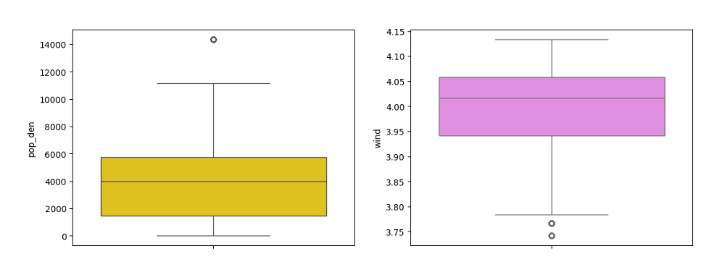
Data Preparation / Cleaning
Missing Data
Missingness Solution ⇒ Listwise deletion
Duplicates
Solution ⇒ Removed duplicated records
Outliers
Boxplots

Slide 6
Data Exploration & Visualization

Slide 7
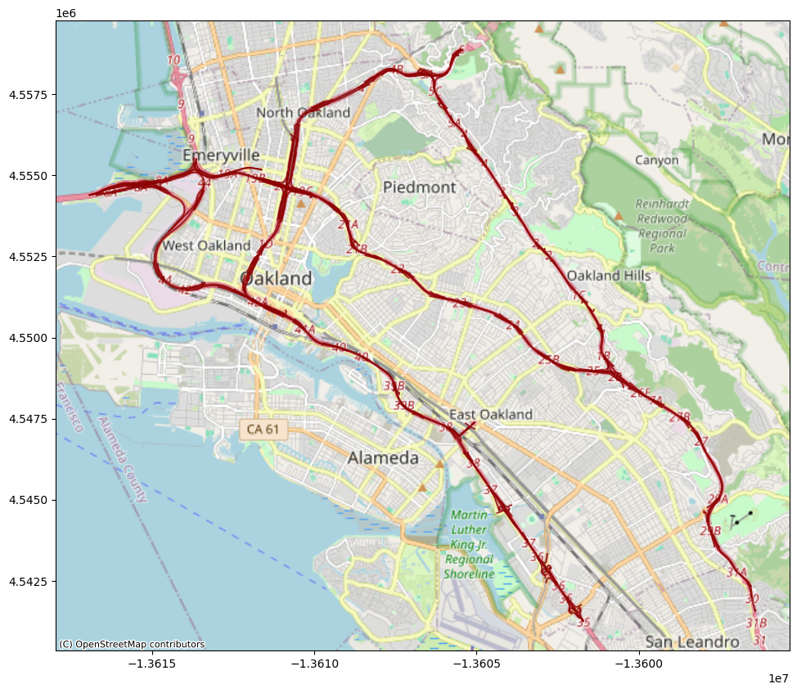
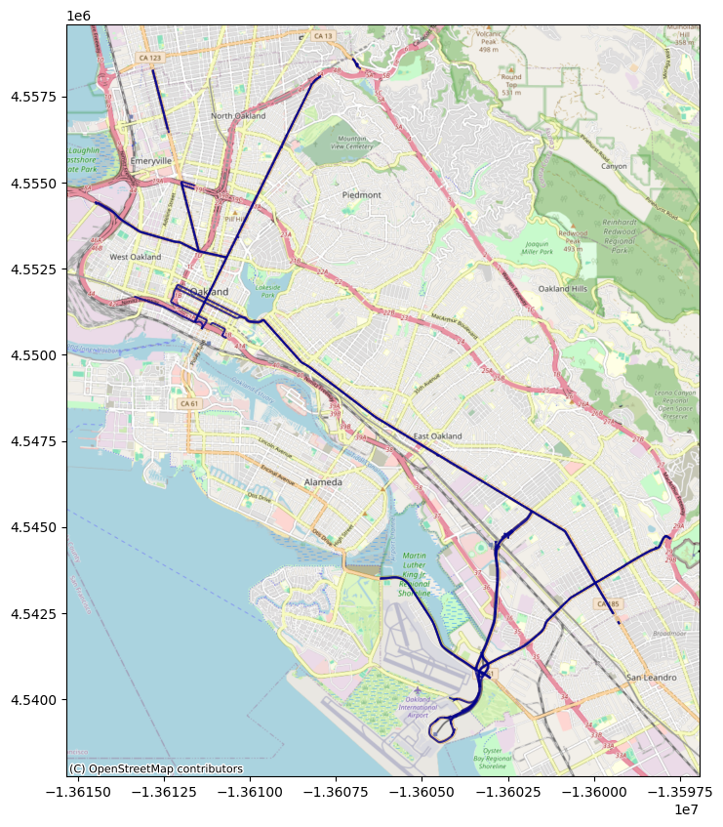
Road type: Highway
Road type: Primary road
Map Visualization

Slide 8
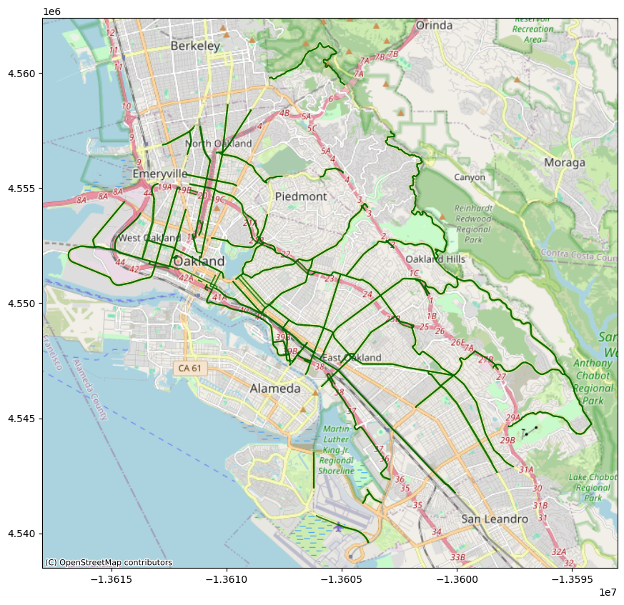
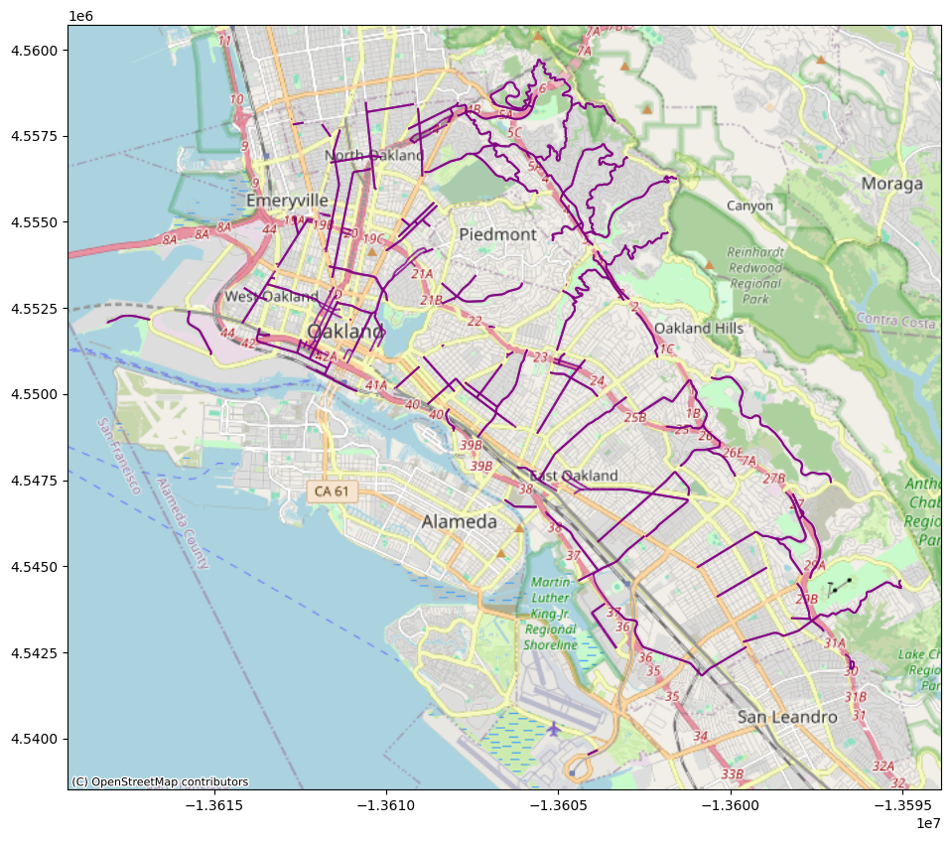
Road type: Secondary road
Road type: Tertiary road
Map Visualization

Slide 9
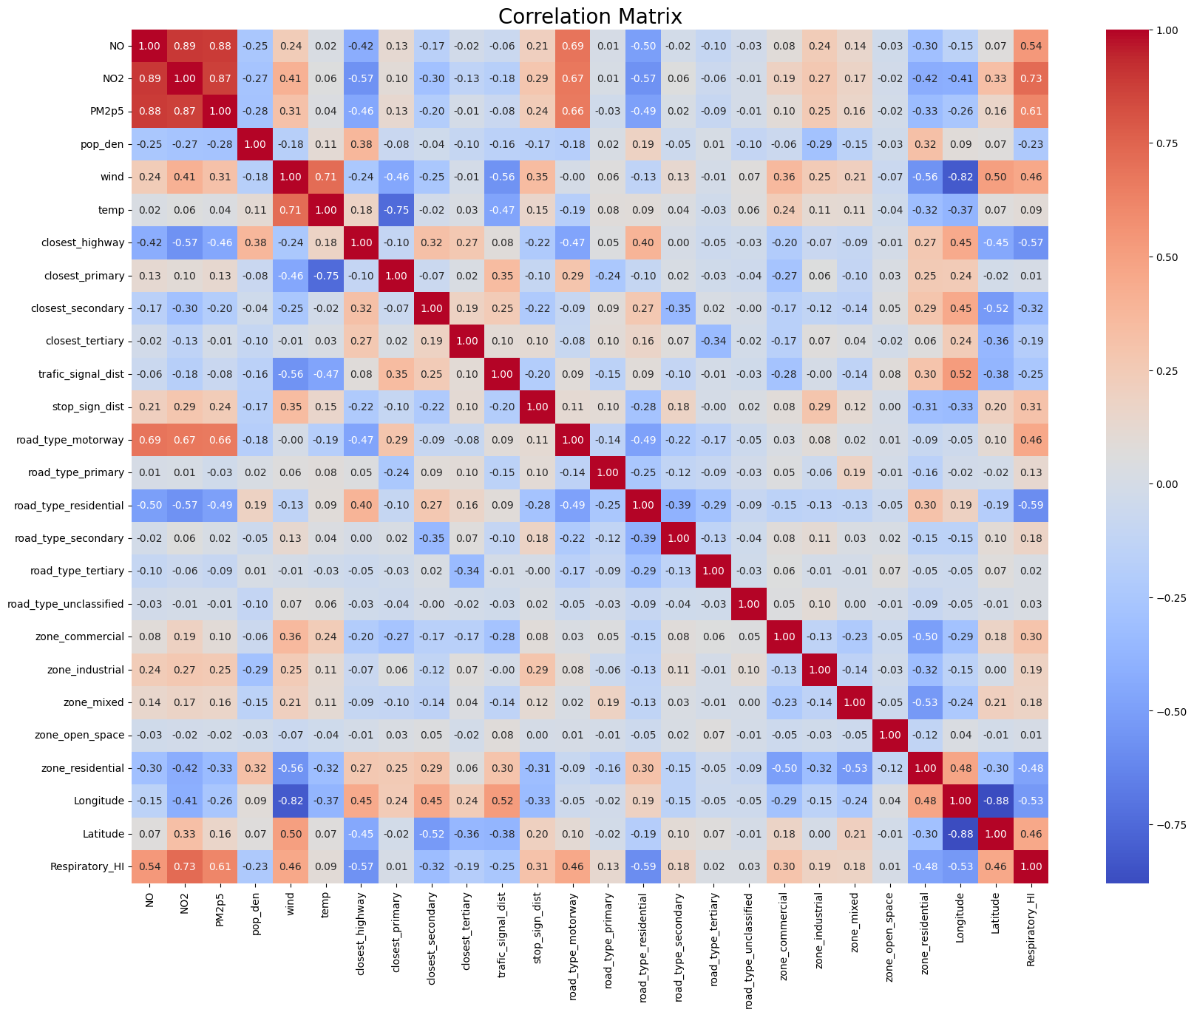
Correlation Matrix

Slide 10
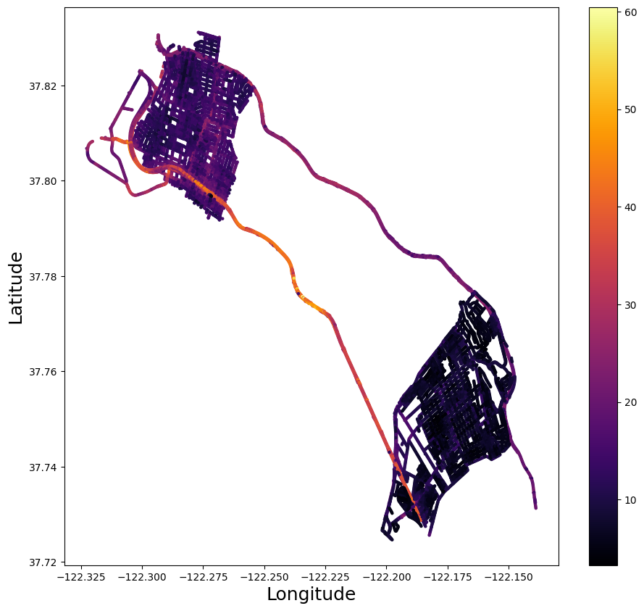
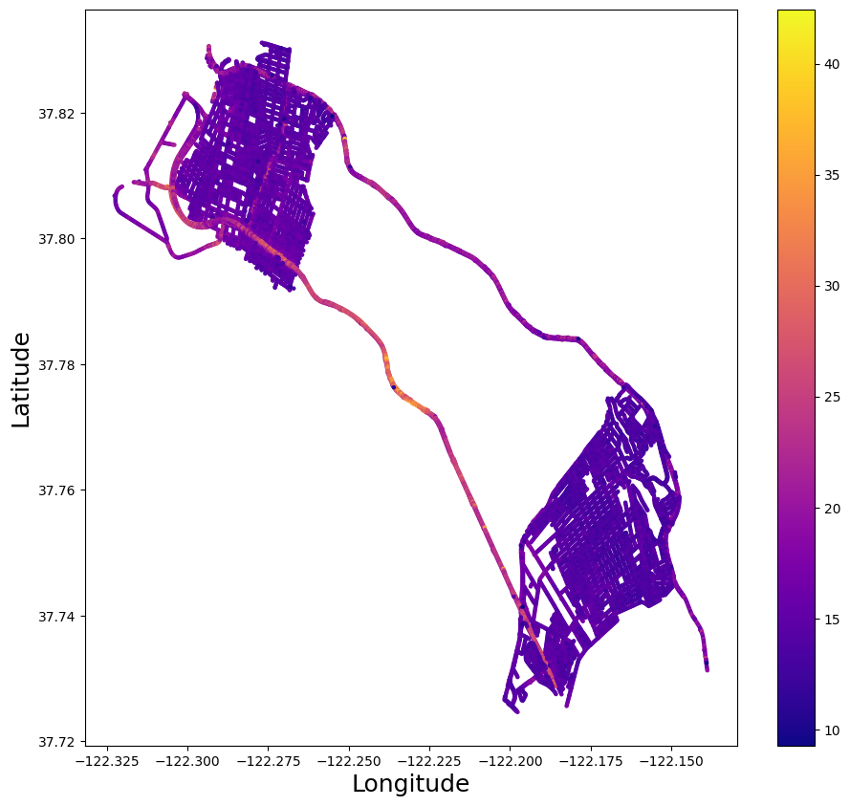
Plot the overall heatmap of NO2
Plot the overall heatmap of PM 2.5

Slide 11
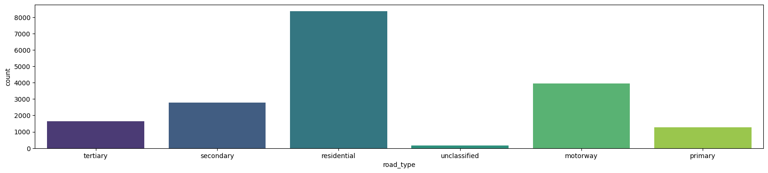
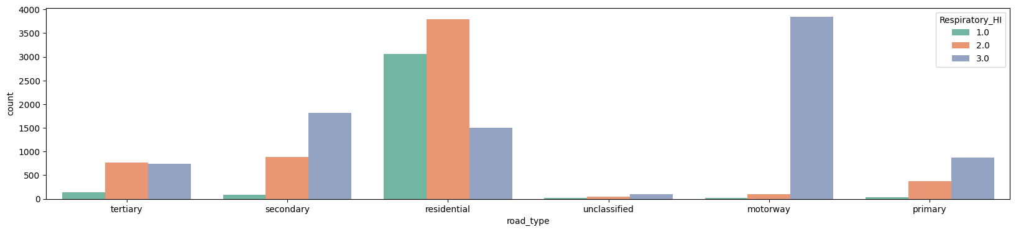
Road Types
Road Types & Respiration Health Level

Slide 12
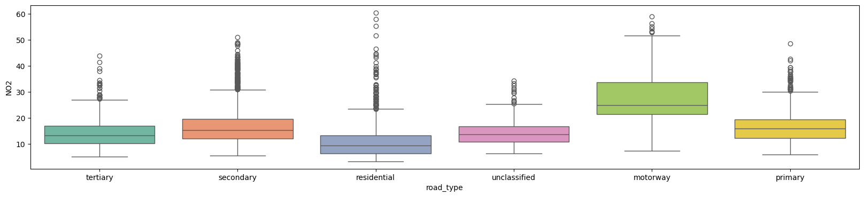
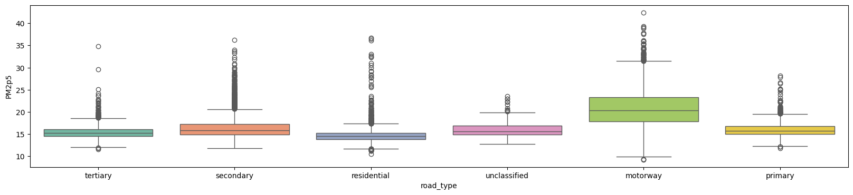
Road Types & NO2
Road Types & PM 2.5

Slide 13
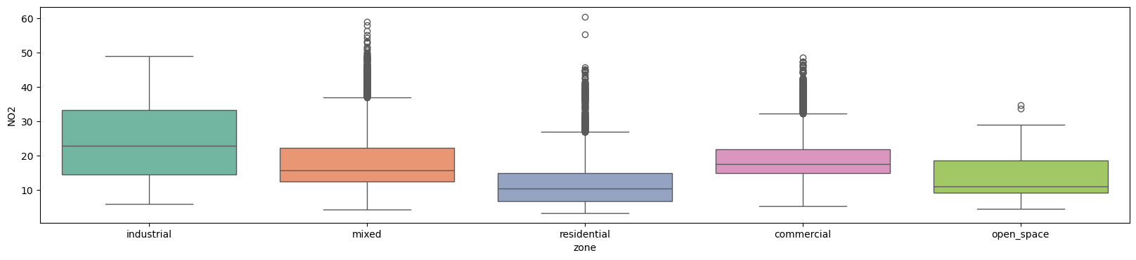
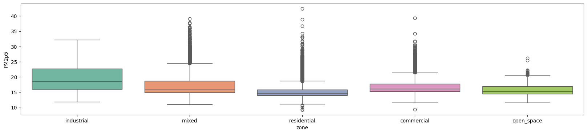
Zone Types & NO2
Zone Types & PM 2.5

Slide 14
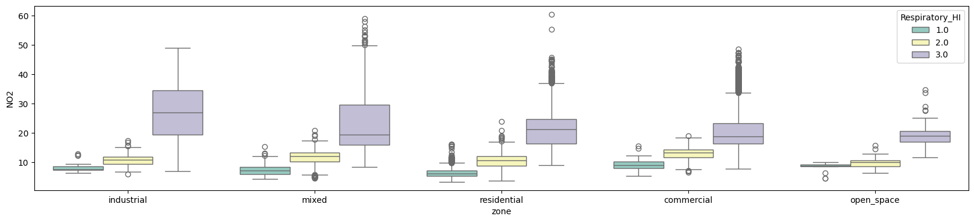
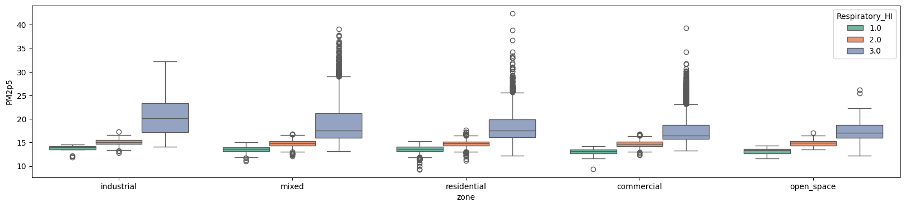
Zone Types & NO2 & Respiration Health Level
Zone Types & PM 2.5 & Respiration Health Level

Slide 15
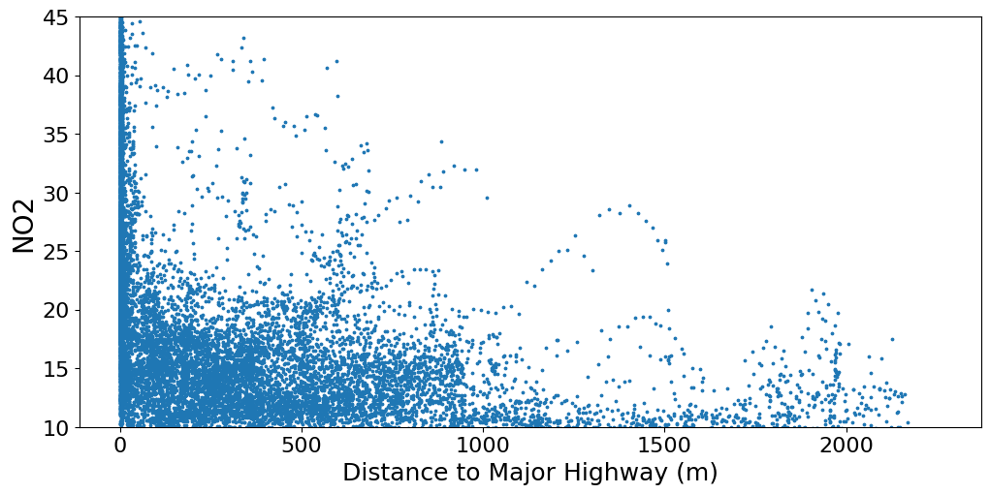
Distribution of NO2

Slide 16
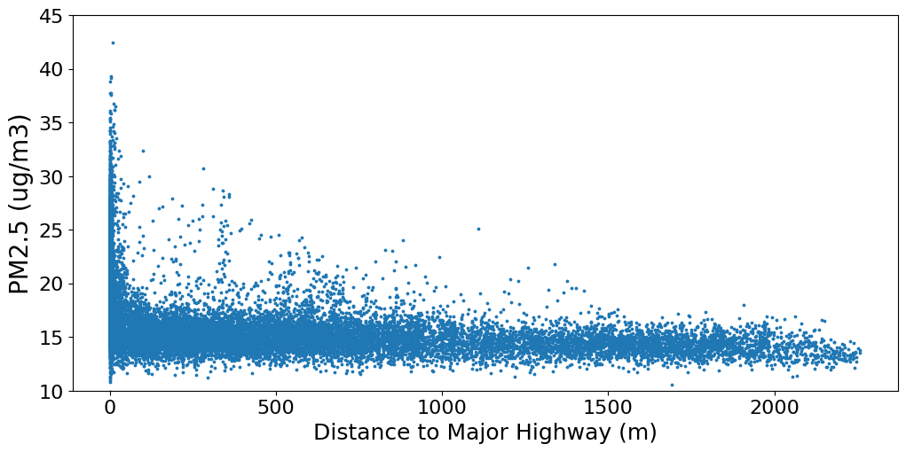
Distribution of PM 2.5

Slide 17
Feature Engineering
Categorical Features
Numerical Features
One hot encoding
Ordinal encoding
Standardization

Slide 18
Model Training
N = 18217
Training set: N=13662 (75%)
Testing set: N=4555(25%)
Ensemble learning - Bagging
Ensemble learning - Boosting
M1. Random Forest Regression
M2. Gradient Boosting Regression
Select the Best Model
Identified RF Model
Identified GB Model

Slide 19
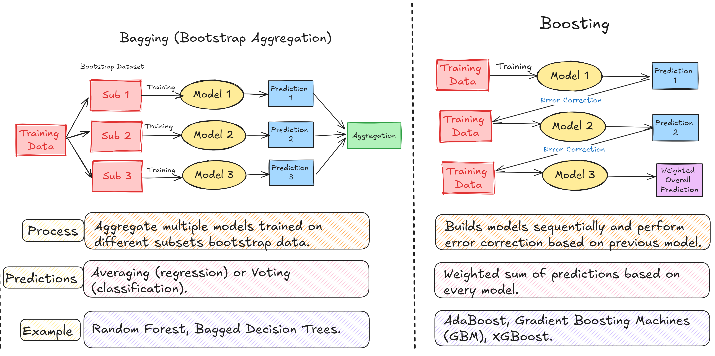
Model 1. Random Forest Regression
Model 2. Gradient Boosting Regression

Slide 20
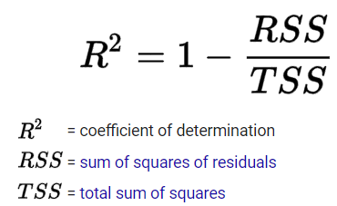
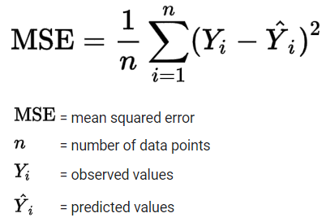
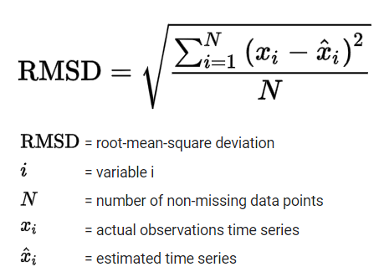
Model Evaluation
Model Evaluation Criteria:
R^2 determines the proportion of variance in the target/label variable that can be explained by independent variables. Therefore, the higher the better.
MSE represents mean squared error. It indicates the average squared difference between the estimated values and the actual value. Therefore, the lower the better and 0 means the model is perfect.
RMSE measures measures the average difference between values predicted by a model and the actual values. Therefore, lower values indicate better fit.
Evaluation Metrics:
R^2
MSE
RMSE

Slide 21
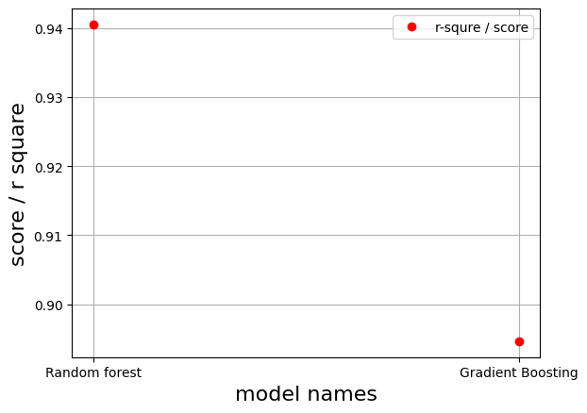
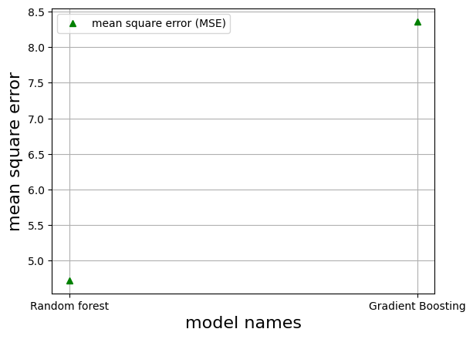
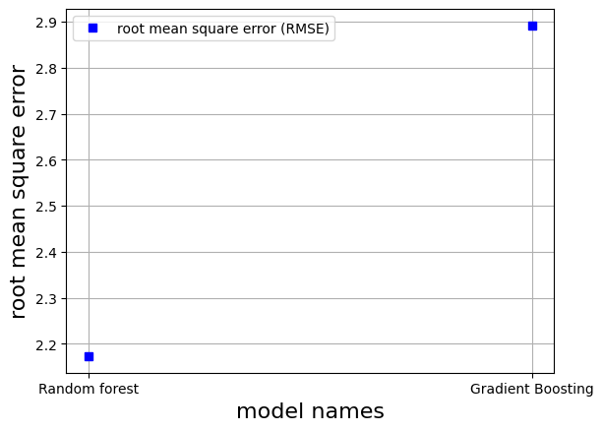
According to MSE, RMSE, and R square, the Random Forest Regression performance better than Gradient Boosting Regression.

Slide 22

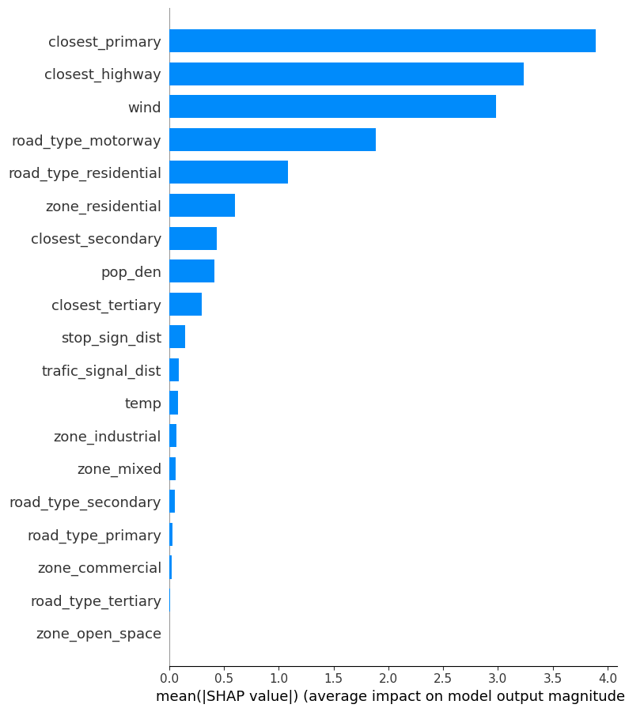
Follow- up Analysis: Feature Importance in Random Forest Regression
Top 5 Features:
Closest_primary
Closest_highway
wind
road_type_motorway
road_type_ residential

Slide 23
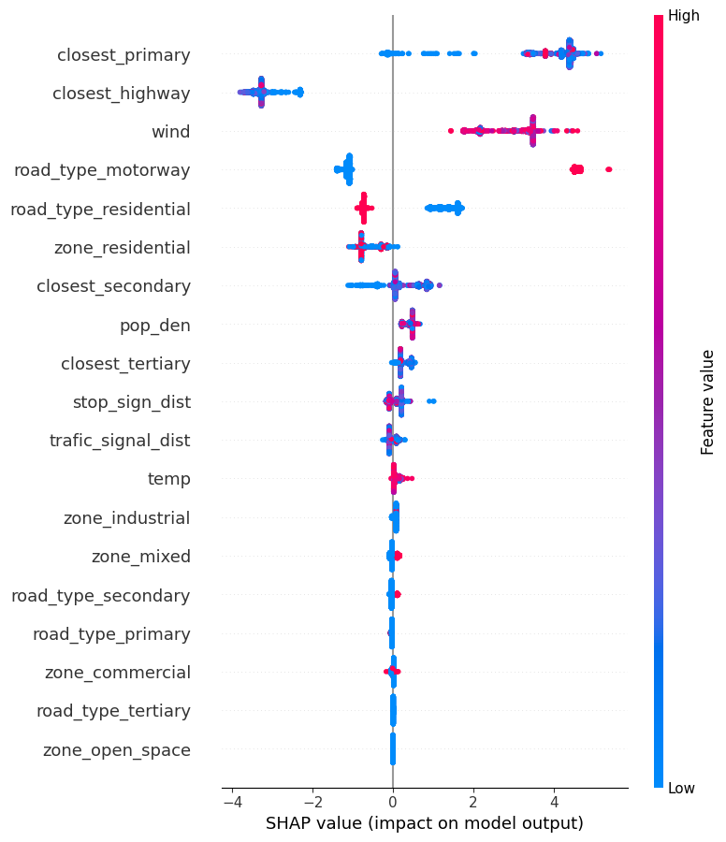
Findings:
Traffic proximity dominates NO₂ prediction
Wind speed strongly reduce NO₂
Residential and open-space areas correspond to lower NO₂, while commercial and industrial zones contribute modestly to higher NO₂
Meteorological and demographic factors amplify patterns

Slide 24
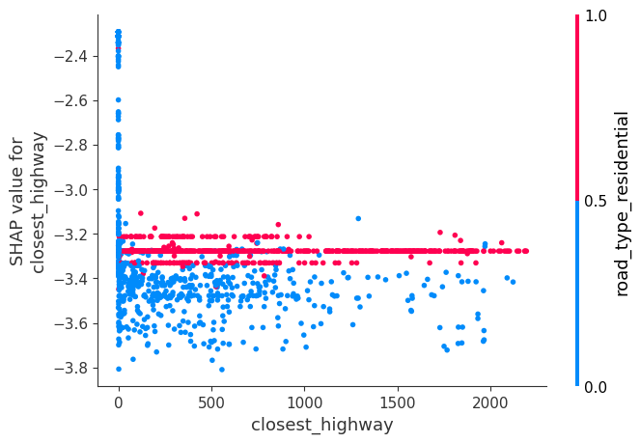

Slide 25
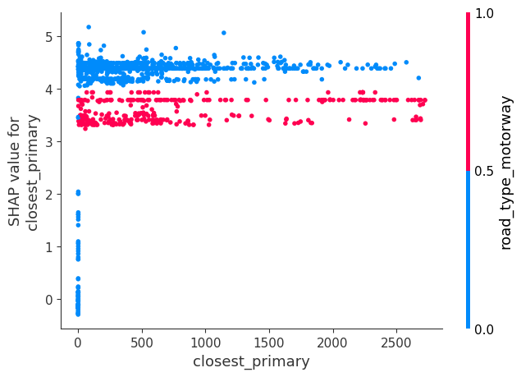

Slide 26
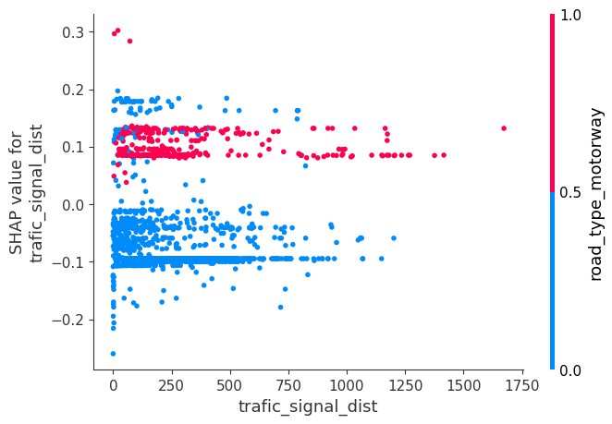

Slide 27
Summary
Traffic-related: Distance from motorways and highways is the most influential factor lowering NO₂, confirming that vehicular emissions dominate NO₂ patterns. For example, being farther than ~800 m from a highway reduces NO₂ concentration, less exposure to vehicle exhaust. No nearby primary road also contributes to cleaner air.
Land use: Residential zones are cleaner; non-residential or mixed-use zones raise NO₂, likely due to industrial or commercial sources
Meteorological: Low temperature and weak wind slightly reduce predicted NO₂ in this instance, though the wind effect could vary regionally.
Model reliability: The strongest LIME coefficients (around −4.5 to −5.0) belong to traffic proximity features, suggesting the regression model heavily relies on spatial road network variables to estimate NO₂.

Slide 28


Thank you!
Feel free to contact me at
Lin.jobapply@gmail.com
https://github.com/DoreenDoreen

